Slide 1
ASSIGNMENT
How to create an account on Microsoft Azure
Made by: Yusuf j
KTC Hubli

Slide 2
What is Microsoft Azure
Microsoft Azure, formerly known as Windows Azure, is Microsoft's public cloud computing platform. It provides a range of cloud services, including compute, analytics, storage and networking. Users can pick and choose from these services to develop and scale new applications, or run existing applications in the public cloud.
The Azure platform aims to help businesses manage challenges and meet their organizational goals. It offers tools that support all industries -- including e-commerce, finance and a variety of Fortune 500 companies -- and is compatible with open source technologies. This provides users with the flexibility to use their preferred tools and technologies. In addition, Azure offers 4 different forms of cloud computing: infrastructure as a service (IaaS), platform as a service (PaaS), software as a service (SaaS) and serverless.
Microsoft charges for Azure on a pay-as-you-go basis, meaning subscribers receive a bill each month that only charges them for the specific resources they have used.

Slide 3
Steps to creae microsoft azure account
Step 1: open your internet browser(chrome,mozila firefox,microsoft edge)
Step 2: search microsoft azure on it
Step 3: on the top right corner there is an option called free account click on the free account

Slide 4
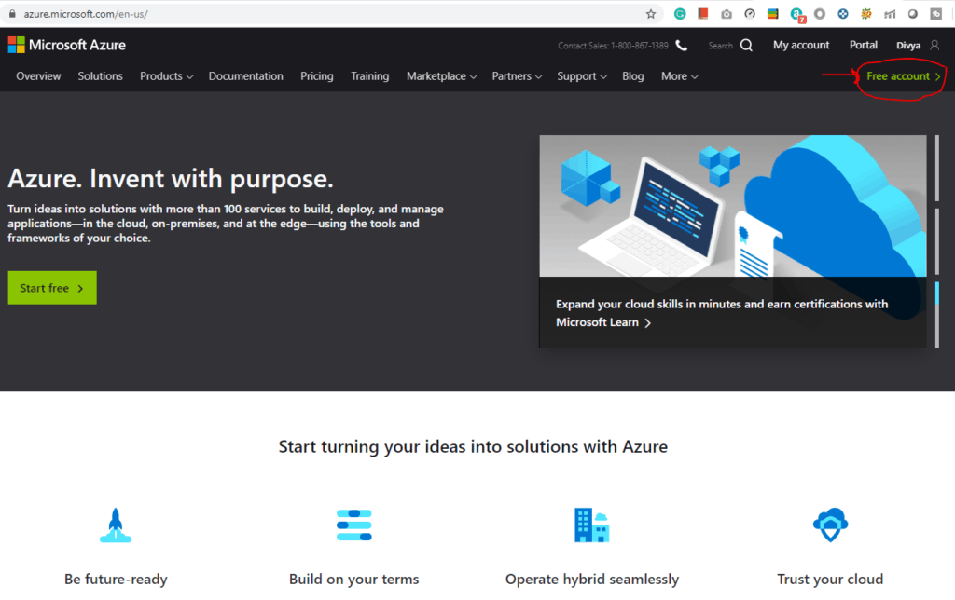

Slide 5
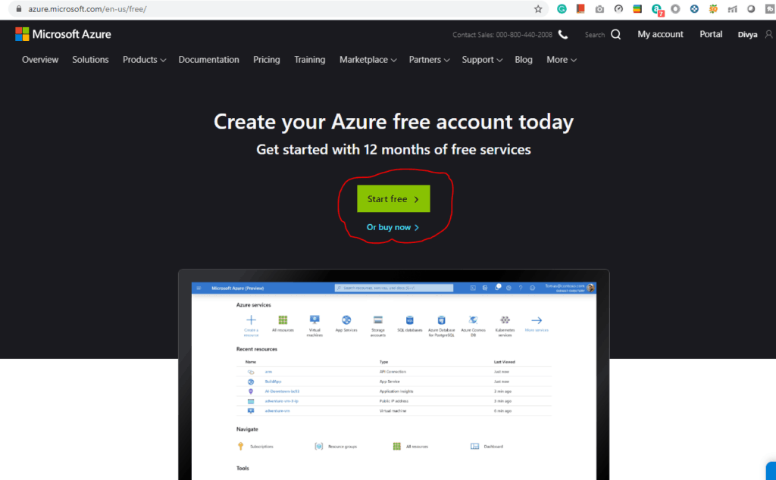
Step 4: then click on start free

Slide 6
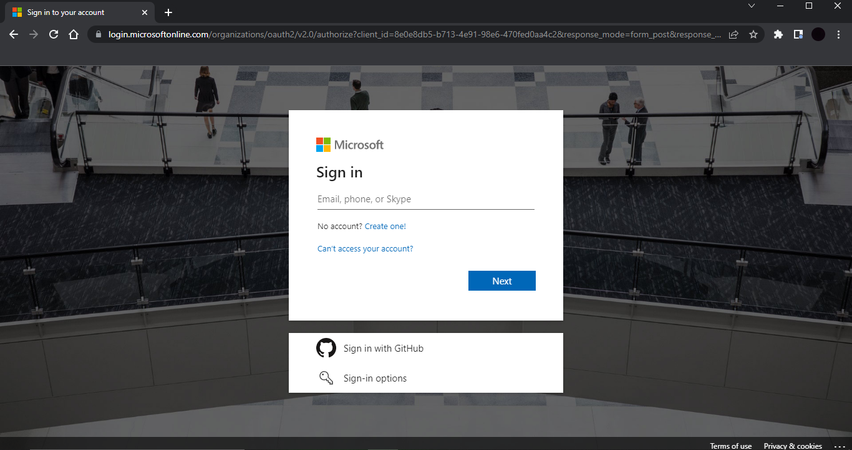
step 5: Sign-in/Sign-up for a Microsoft account using an email address and password.
Or you can sign in with GitHub account

Slide 7
Step 6: Enter your Country/Region and Date of Birth and click next.
step 7: Enter the verification code received on the email address and
Step 8: Type the captcha you see on your screen and click on next.t
Step 9: You’ll be redirected to the Azure Sign-up page. Enter your Region, Name, Phone number, Email address. Note: You should use the same email address for Azure sign-up and for the Microsoft account.
Step 10: Verify your phone number by clicking Text Me or Call Me and enter the verification code received.

Slide 8
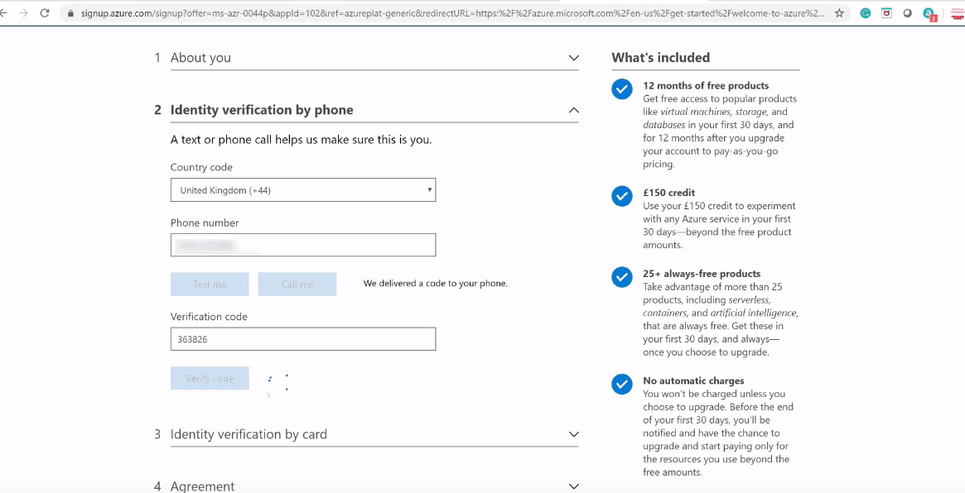

Slide 9
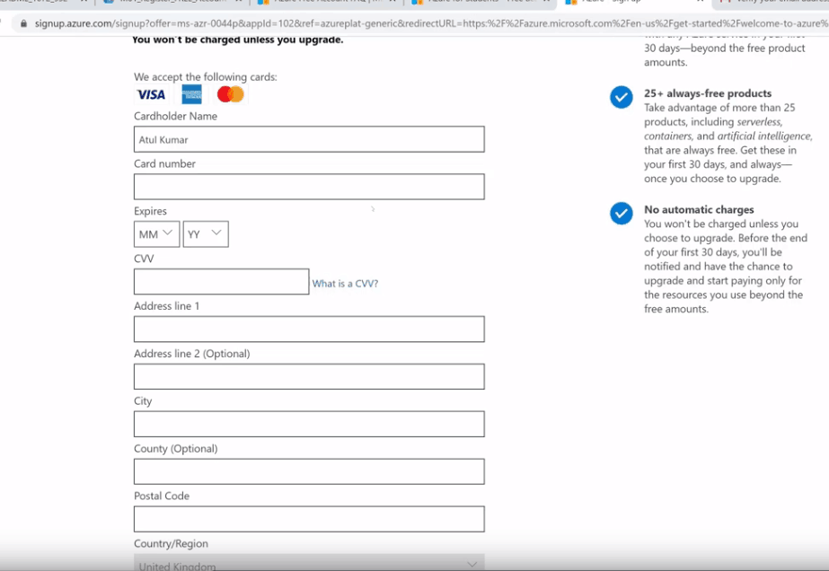
Step 11: Enter the payment details. Make sure you have a Master Card/Visa card and international payments should be enabled.

Slide 10
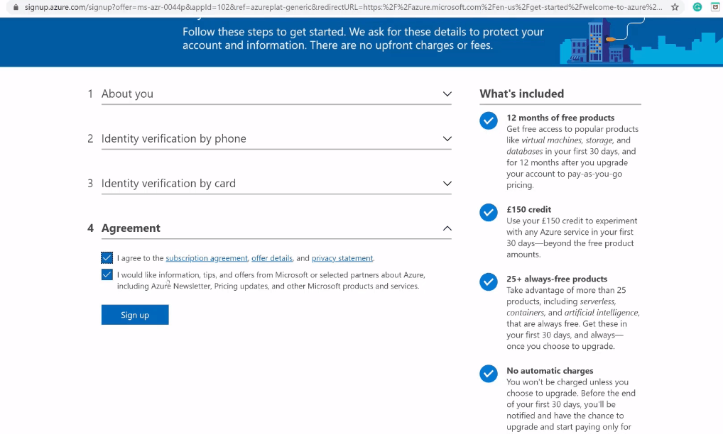
Step 12: Check the Terms and Conditions and click Sign-up.

Slide 11
You have successfully created a Microsoft Azure free account
THANKYOU

